Slide 1
Adaptive Media Streaming over IP Multicast (mABR):
A Data Analytic Evaluation
Arsham Farshad, Mike Nilsson, Steve Appleby
ViSNext
Rome, Dec 2022

Slide 2
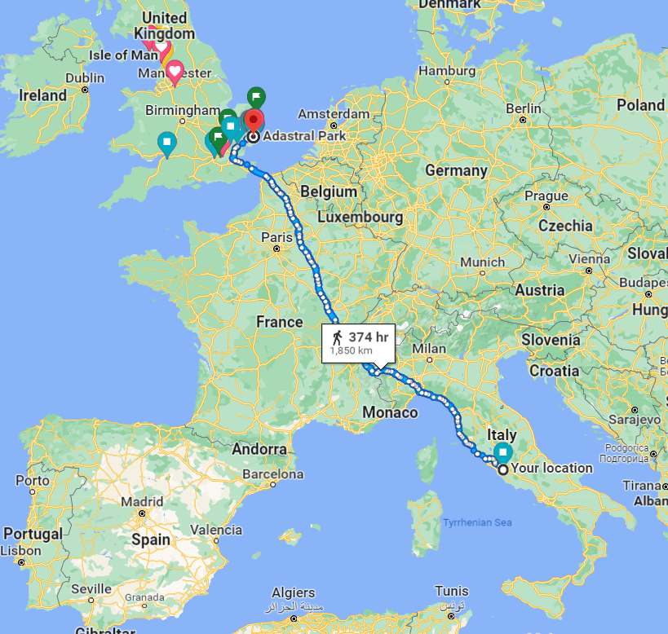


Slide 3


TV, Content & Communications
Video Networking
Immersive & Interactive Applications
How should we architect the future converged network to support video & media services, to minimise infrastructure costs and deliver best QoE, supporting a transition of DTT to all-IP delivery.
What are the future video streaming and encoding formats which will enable efficient content delivery and enable new forms of immersive content.
How do we differentiate content applications delivered over BT’s converged network, with best quality & interactivity to deliver an immersive experience.
What are the new media rich, immersive and interactive applications which can leverage high bandwidth, low latency networks and what are the value-added network capabilities to underpin new application experiences.
Converged Media Delivery
Future video formats
Object based Broadcasting
Immersive Media
Multi-modal Service Experiences
Converged Audio
TV Analytics
How do we deliver the best quality, high-fidelity voice and converged multimedia communications.
How can we improve voice service diagnostics, enhance voice quality and integrate new codec technologies to deliver best audio quality and reliable converged communications.
How can we best apply advanced data analytics and AI/ML tools and techniques to develop enhanced network and service management capabilities, to create the best customer experience for content services delivered over BT networks.
How can we enhance the user experience and user interface for the BT content services and applications.
Voice QoE
Pervasive Audio
Service Assurance
Personalisation
Optimising Customer Interactions

Slide 4



Satellite and Digital Terrestrial Television - PUSH
All receive the same signal
Millions of clients, all are synchronised
Dedicated CPE (TV sets & STBs)
Multicast (UDP/IP) - PUSH
One ‘copy’ of the signal, replicated in the network
~Millions of clients, all synchronised
Specific devices.
Does not work across the Internet.
Unicast (usually TCP/IP) - PULL
Each client needs its own copy of the signal: millions of clients means millions of streams!
Not synchronised
Wired, wireless, almost any device

Slide 5
What is the Challenge?
HTTP Adaptive Streaming has become the dominant video delivery technology for major live events.
Demand for higher quality contents (66% of connected TV sets will be 4K TV by 2023)
Handling impulsive traffic peaks
Euro 2016 England Game
Just Another Day

Slide 6


What is adaptive bitrate streaming?
ABR algorithms switch between encoding profiles to maintain a balance between likelihood of stalling and media quality.
High Quality (Pos 7)
Seg 1
Seg 2
Seg 3
Seg 4
Seg 5
Seg 6
Medium Quality (Pos 4)
Seg 1
Seg 2
Seg 3
Seg 4
Seg 5
Seg 6
Low Quality (Pos 2)
Seg 1
Seg 2
Seg 3
Seg 4
Seg 5
Seg 6
Player Requests
Seg 1
Seg 2
Seg 3
Seg 4
Seg 5
Seg 6

Slide 7



What is mABR?
Multicast ABR is a streaming technology that combines
the simplicity and global reach of HAS
whilst benefitting from the inherent scalability of multicast
CDN
Node
MC- Srv
MC
BNG
MC- GW
Media Player
UC
MC
UC
UC
Seg 1
Seg 2
Seg 3
Seg 4
Seg 5
Seg 6
Seg 7
Core Network
Edge
Access Net.

Slide 8
Contributions
We use BT Sport Live CDN log data set for Samsung TV HAS player (HD & UHD) to:
Investigate the multicast delivery efficiency in the core
Investigate the synchronous behaviour of the HAS players for a live channel
Explore the cache size requirement for the efficient usage of the MC resources at the edge
Study the effect of the ABR dynamics on the access network

Slide 9
The dynamics of the unicast ABR behaviour
CDN
Node
MC- Srv
MC
BNG
MC- GW
Media Player
UC
MC
UC
UC
Core Network
Edge
Access Net.

Slide 10
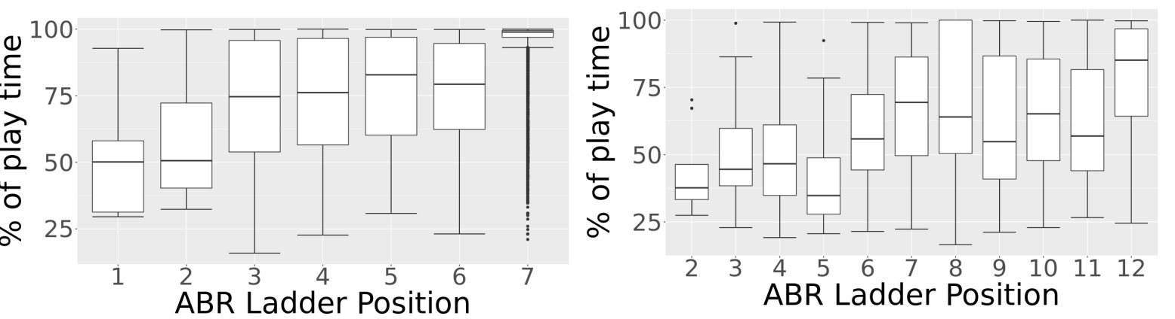
mABR efficiency in the core
Seg 1
Seg 2
Seg 3
Seg 4
Seg 5
Seg 6
Seg 7
Seg 8
Seg 9
% Play Time for the most freq. segments= 55%
HD
UHD
Distribution of the playtime percentage for the most frequently requested ABR level
UHD shows more dynamic behaviour
Enabling mABR for the highest levels is beneficial for both HD and UHD

Slide 11
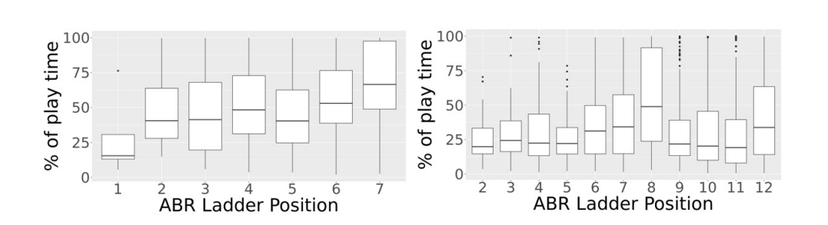
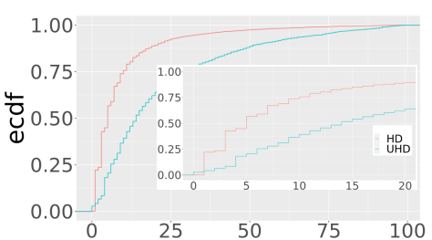
mABR efficiency in the core
Seg 1
Seg 2
Seg 3
Seg 4
Seg 5
Seg 6
Seg 7
Seg 8
Seg 9
% Play Time for the longest period = 33%
HD
UHD
Distribution of the longest period at the most often requested ABR level
No. of video bitrate switches
There is a higher likelihood that UHD players switch to other bit rates
To make best use of the MC resources having a policy to dynamically switch between MC channels of different ABR levels is beneficial

Slide 12
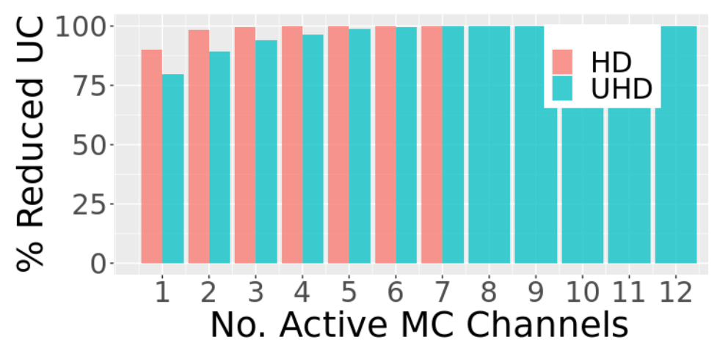
mABR deployment options in the core
Only one active MC channel for streaming the most popular ABR level can reduce the core network traffic by more than 75% for both HD and UHD streams

Slide 13
Synchronous Playing & required cache at the edge
Player 1
Seg 1
Seg 2
Seg 3
Seg 4
Seg 5
Seg 6
Seg 7
Player 2
Seg 1
Seg 2
Seg 3
Seg 4
Seg 5
Seg 6
Seg 7
Player 3
Seg 1
Seg 2
Seg 3
Seg 4
Seg 5
Seg 6
Seg 7
Player 4
Seg 1
Seg 2
Seg 3
Seg 4
Seg 5
Seg 6
Seg 7
Playing time

Slide 14
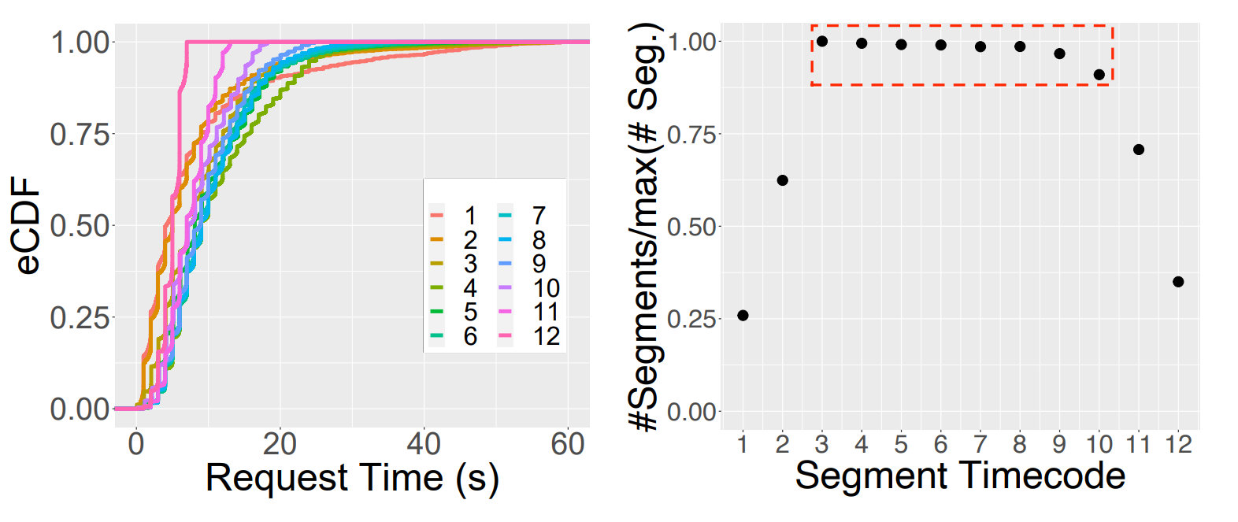
Caching At the Edge
50% of the segments are requested in a 10s period and most of them have been requested by 60s.
with a cache size of 60s a MC-GW could cache segments long enough to satisfy the majority of requests from clients.

Slide 15
mABR Efficiency at Access

Slide 16
mABR Efficiency at Access Network
Media Player
The home gateway will join the IP multicast network on demand by sending the join requests (e.g. IGMP join).
The joining and leaving the MC channels rules are defined by the policies.
Policies are modelled in R and their efficiency are compared using the UHD live data.
CDN
Node
MC- Srv
MC
BNG
MC- GW
UC
MC
UC
UC
Core Network
Edge
Access Net.
Seg 1
Seg 2
Seg 3
Seg 4
Seg 5
Seg 6
Seg 7
Player Requests
time

Slide 17
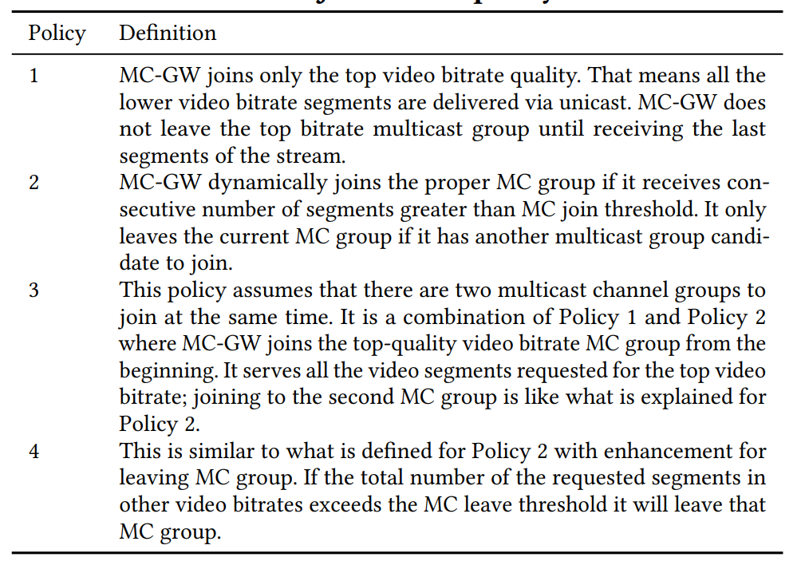
Joining and Leaving Policies

Slide 18
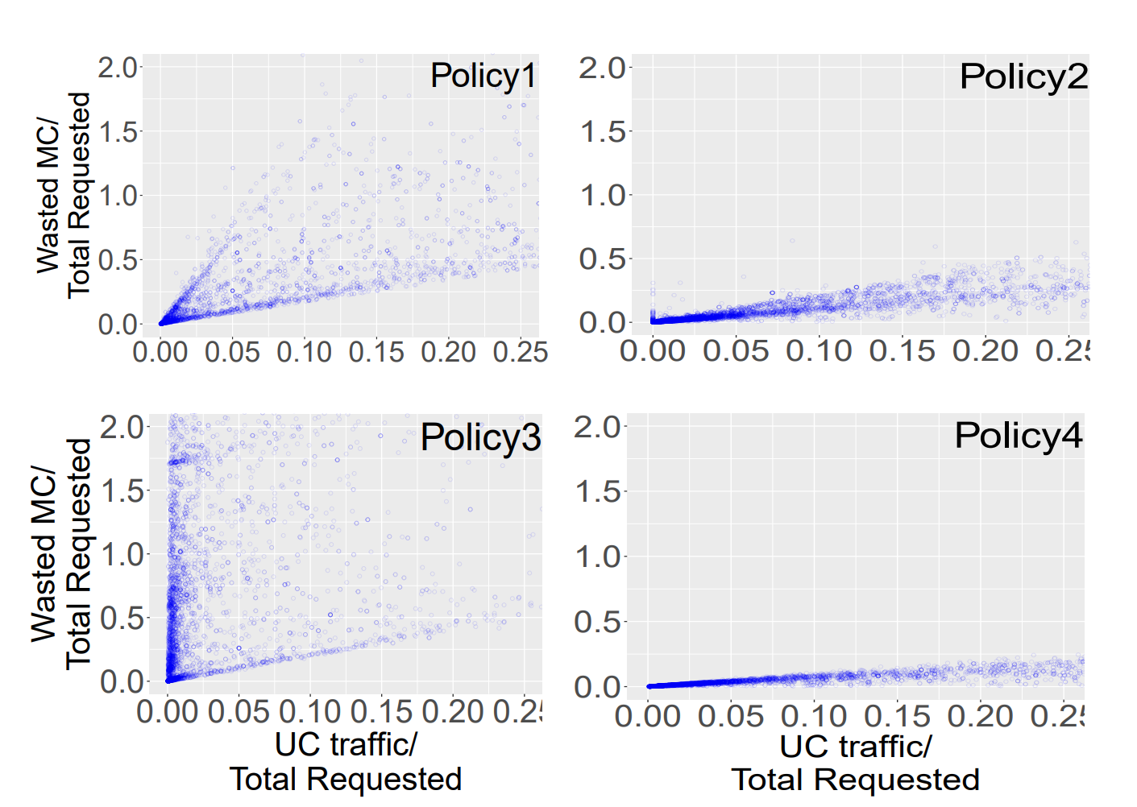
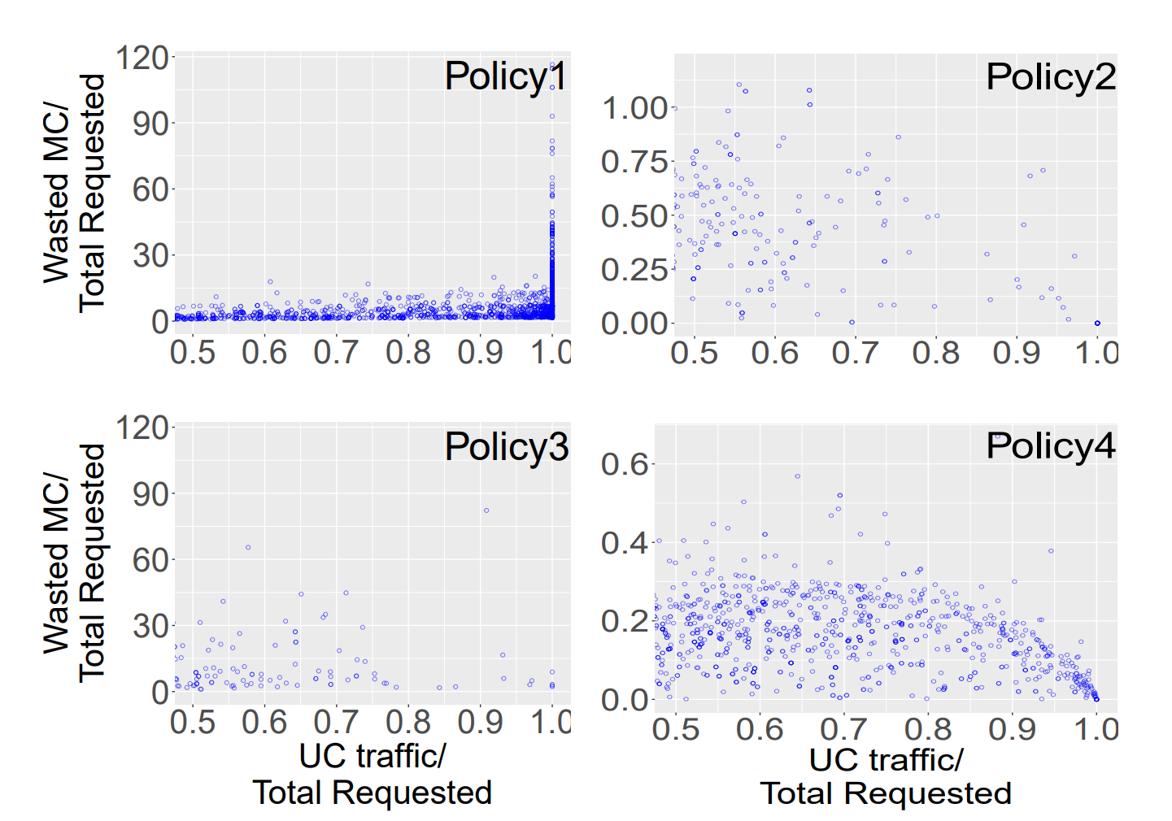
mABR Efficiency at Access Network
If all ABR levels are available to the edge of the network more adaptive policies similar to Policy 2 or Policy 4 are more bandwidth efficient
The most efficient policy is the one with the smaller wasted MC values and the smaller UC used values

Slide 19
Thank You

