Slide 1
ViSNext’22
Multi-Preset Video Encoder Bitrate Ladder Prediction
Fatemeh NASIRI

Slide 2
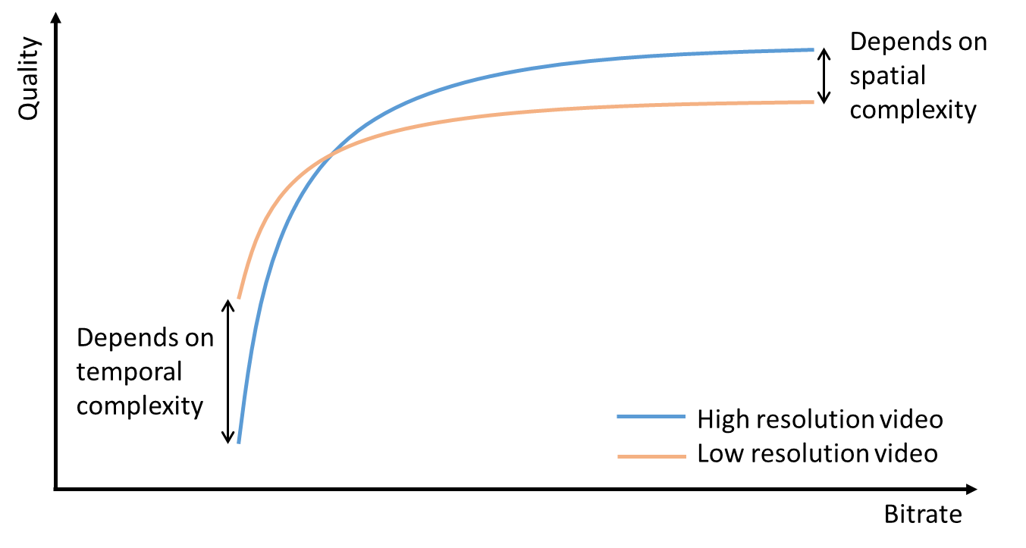
Down-sampling in low bitrate video coding
At low bitrate:
Number of bits for motion vectors and residual information are comparable.
Fewer bits for residual ➔ quantization distortion
At high bitrate:
More bits for residual information
Up-sampling distortion.
Low resolution is better
High resolution is better
Down-sampling can be beneficial for low bitrate ranges

Slide 3
Where does video get down-sampled?
HTTP Adaptive Streaming (HAS)
Through different standards and protocols (DASH, HLS etc.)
Quality
Quality
Best
Best
Bandwidth
Medium
Medium
Low
Low
Time
Time
Internet
HTTP server
(hosting video content)
Network
(variable bandwidth)
Client

Slide 4
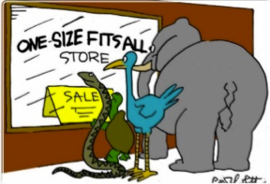
Bitrate ladder
One static ladder for HEVC
Static or “One-size-fits-all” bitrate ladder
The main drawback:
Its recommendation scheme is the same for all video contents, regardless of their spatio-temporal features.
16:9 aspect ratio | HEVC/H.265 30 fps | HDR (HEVC) 30 fps | Frame rate
640 x 360 | 145 | 160 | ≤ 30 fps
768 x 432 | 300 | 360 | ≤ 30 fps
960 x 540 | 600 | 730 | ≤ 30 fps
960 x 540 | 900 | 1090 | ≤ 30 fps
960 x 540 | 1600 | 1930 | Same as source
1280 x 720 | 2400 | 2900 | Same as source
1280 x 720 | 3400 | 4080 | Same as source
1920 x 1080 | 4500 | 5400 | Same as source
1920 x 1080 | 5800 | 7000 | Same as source
2560 x 1440 | 8100 | 9700 | Same as source
3840 x 2160 | 11600 | 13900 | Same as source
3840 x 2160 | 16800 | 20000 | Same as source
https://developer.apple.com/documentation/http_live_streaming

Slide 5
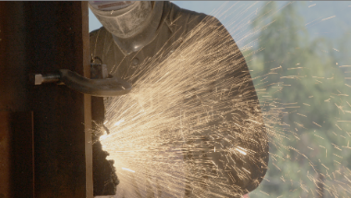
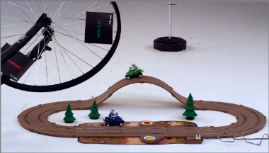
Bitrate ladder and content dependency
Complex content
Simple content

Slide 6
Content-adaptive bitrate ladder
Netflix (Per-title encoding)
Bitmovin (Per-title encoding )
Efficient Bitrate Ladder Construction (Katsenou, A , et al.)
They obtain R-D points by running several trial encodings
Construct the convex hull
PSNR and VMAF
Complexity analysis, Feature extraction
ML-based method to predict the convex hull and construct the adjusted bitrate ladder.
ML-based method
Predicts the cross-over points in R-D curves.
Fixed QP
PSNR and VMAF
Katsenou, A. V., Sole, J., & Bull, D. R. (2021). Efficient bitrate ladder construction for content-optimized adaptive video streaming. IEEE Open Journal of Signal Processing, 2, 496-511.

Slide 7
Bitrate Ladder Construction Multi-preset ML-based Bitrate Ladder Construction

Slide 8
Content-specified bitrate ladder
$r$ : target bitrate
$v$ : Input video
$s_{i}$: resolution
$$S=\{s_{1},s_{2},…,s_{|S|}\}$$
$$q=E(v, r,s_{i}), where s_{i}∈S$$
$q$ : quality index
Full rate-quality points
$E$ : Encoder
Scaled PSNR
Log(Bitrate (kbps))

Slide 9
Content-specified bitrate ladder
$C$ : Convex-hull
$E$: Encoder
$q^{∗}$ : Best quality
Full rate-quality points
Convex-hull
Scaled PSNR
Scaled PSNR
Log(Bitrate (kbps))
Log(Bitrate (kbps))

Slide 10
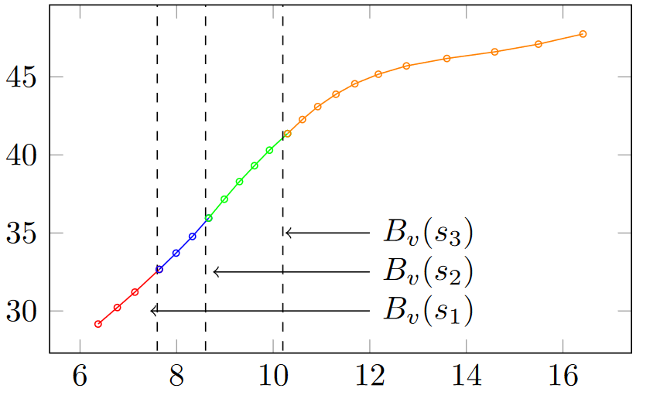
Content-specified bitrate ladder
Cross-over bitrate
index of the optimal resolution
Bitrate ladder
Cross-over bitrates
Bitrate ladder
Scaled PSNR
Resolution Index
Log(Bitrate (kbps))
Log(Bitrate (kbps))

Slide 11
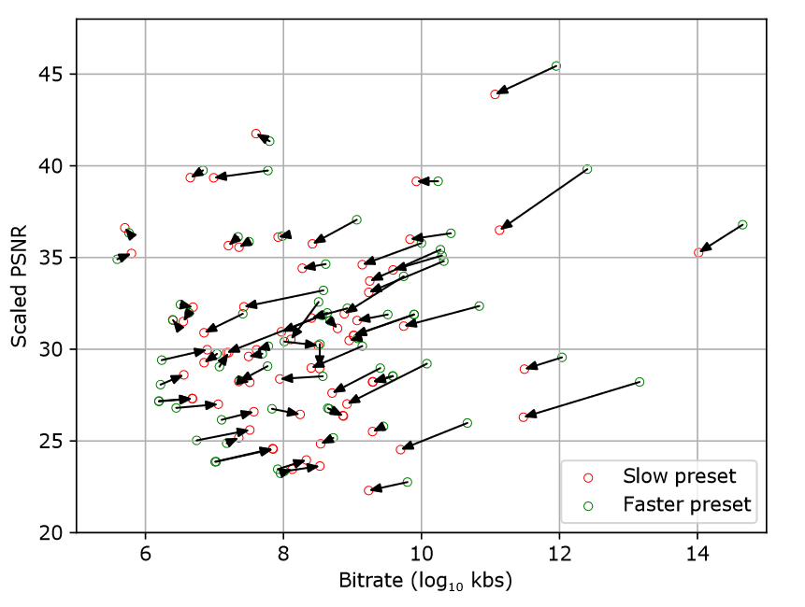
Fast-pass method
Multi-preset encoder
5 presets in VVenC encoder:
“Faster”
“Fast”
“Medium”
“Slow”
“Slower”
Estimate a slower preset’s bitrate ladder from a faster preset’s bitrate ladder
The relative position of cross-point bitrates of the “slow” preset of VVenC, with respect to its “faster” preset.

Slide 12
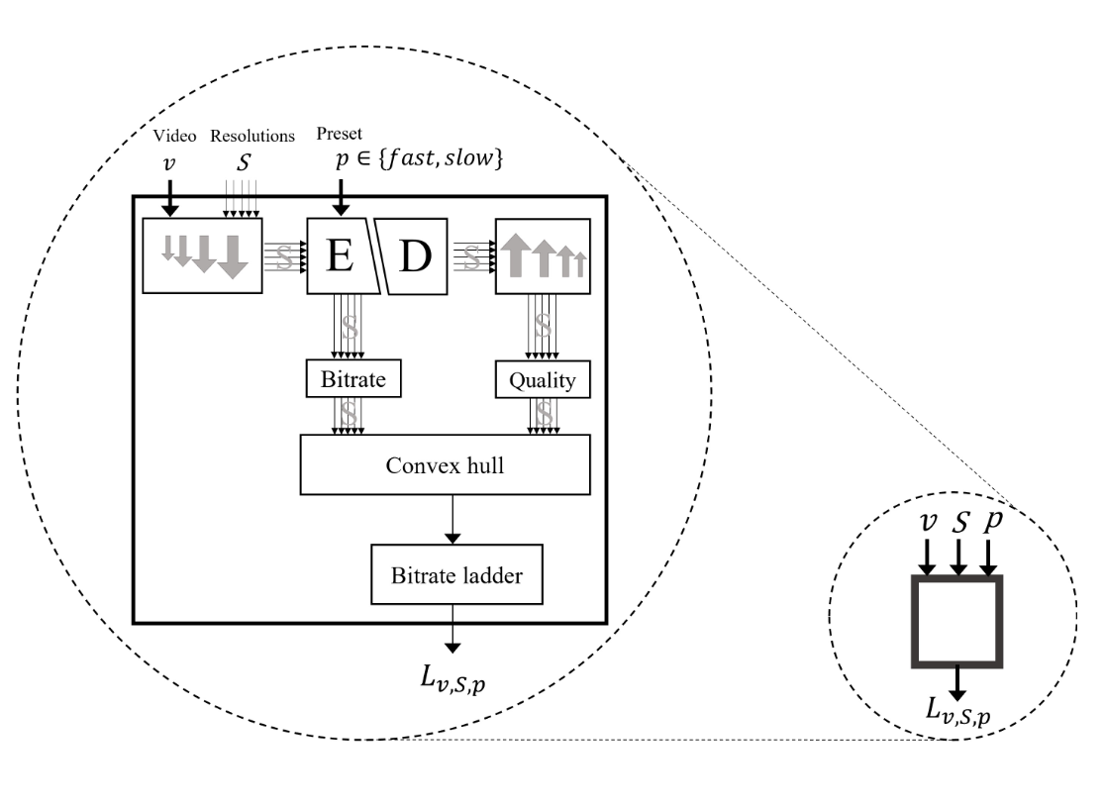
Fast-pass method
A slow preset bitrate ladder
video
A fast preset bitrate ladder

Slide 13
Fast-pass method: training
$p:$ slow
$p:$ fast
$$S$$
$$v$$
Signal feature extractor
$$L_{v,S,}^{∗}$$
slow
$$L_{v,S,}^{∗}$$
fast
(Ground truth)
$$r_{i,}^{∗}$$
fast
$$r_{i,}^{∗}$$
Test
slow
Concatenate
Train
Train model M
Model M
$$r_{i,}$$
slow
$$L_{v,S, }$$
slow

Slide 14
Bitrate Ladder Construction Experimental Results

Slide 15
Results/ Dataset
Different resources: BVI SR, Derf collection, MCML, UHD videos, 4:2:0, 8 bits
Segment duration: 1 second
Features:
Gray level concurrence matrix
Temporal coherency
Spatial Index (SI)
Temporal Index (TI)

Slide 16
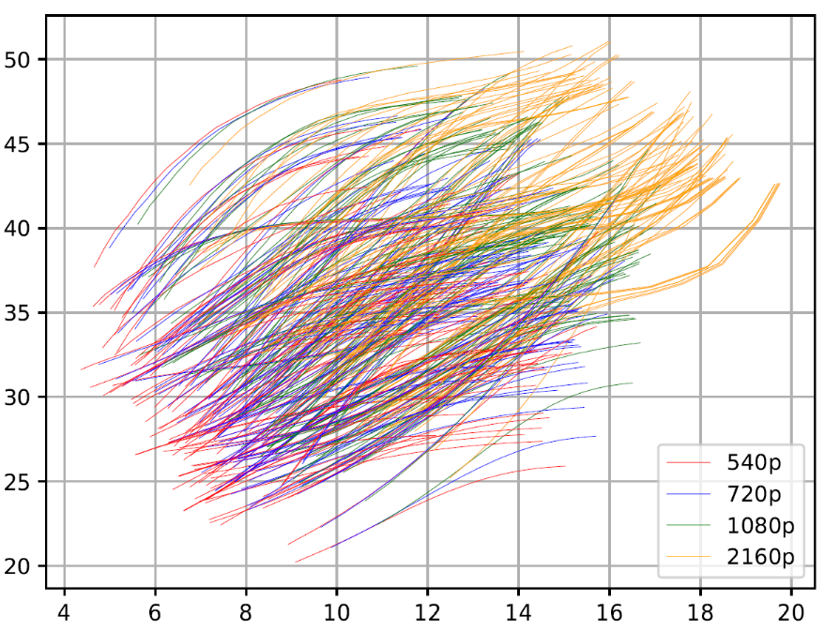
Results/ Reference convex hull construction
Four resolutions: 2160p, 1080p, 720p and 540p.
Encoded with VVenC, “faster” preset
Convex-hull is constructed for all segments in the training dataset.
To avoid overfitting, we used the 10-fold random cross validation.
Regressor: Gradient process.
Scaled PSNR
Log(Bitrate (kb/s))

Slide 17
Results/ Fast-pass
Preset bitrate ladder predicted from “faster” bitrate ladder | BD-BR vs GT | BD-BR vs Static | Acceleration of the proposed method compared to GT
“Fast” | 0.79% | -9.44% | 25%
“Medium” | 0.67% | -8.60% | 75%
“Slow” | 0.88% | -8.32% | 91%
Loss, since we are avoiding full bitrate-quality points calculation in GT
Gain, since we are adapting the bitrate ladder to content

Slide 18
Conclusion

Slide 19
Conclusion
Down-sampling is beneficial in adaptive video streaming
The static “one-size-fits-all” bitrate ladder has obvious drawbacks
We proposed a machine learning method for bitrate ladder prediction of a slow preset from a fast preset of the same encoder.
Significant compression gain when ladder is predicted with our method compared to static bitrate ladder

